Slide 1
Parse all the things
(with FParsec!)

Slide 2

Community Bulletin
Dugnad discussion on FSSF Slack Thursday (http://fsharp.org/guide/slack)
F# Weekly Issues are out (https://sergeytihon.com/category/f-weekly)
F# Advent Calendar 2019 (https://sergeytihon.com/2019/11/05/f-advent-calendar-in-english-2019)

Slide 3
PArsing

Slide 4
Unstructured
???
Structured

Slide 5
PArse
Don’t parse
Typed Domain Objects
Limit Problem Space
Express Intent
Complex Types
High-Effort
Flexible
Low-Effort
Primitive Types

Slide 6
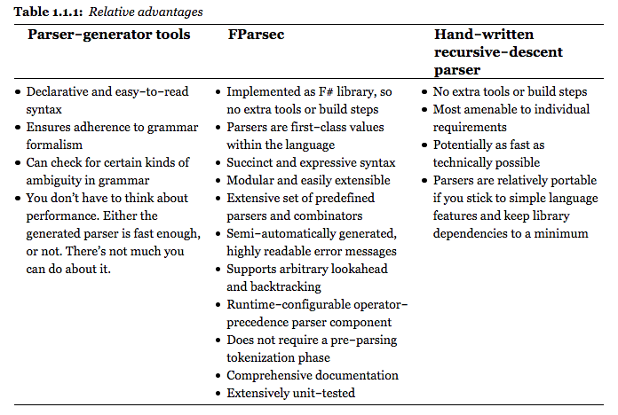

Slide 7
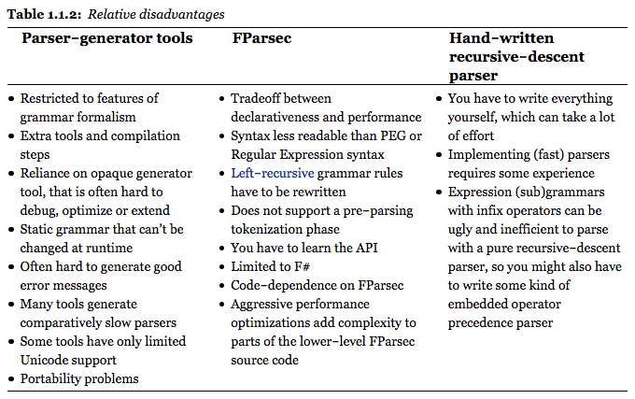

Slide 8
Fparsec Basics

Slide 9
Parsers
type Parser<'T, 'State> = CharStream<'State> -> Reply<'T>
Notes:
Core type.
Abstracts away moving through the stream you’re parsing.
Either implement the function yourself, or use the combinators/CE instance.

Slide 10
ParseR Results
type ParserResult<'Result,'UserState> =
| Success of 'Result * 'UserState * Position
| Failure of string * ParserError * 'UserState

Slide 11
Simple parsers
let anyCharNotNewline = satisfy (fun c -> c <> '\r' && c <> '\n’)
let hi = pstring "hi"
let allHi = pstringCI "hi"
pfloat
spaces

Slide 12
Complex parsers
let charBetween min max =
satisfy (fun c ->
let b = byte c
min <= b && b <= max)
let upperChar = charBetween (byte 'A') (byte 'Z')

Slide 13
Chaining Parsers
val ( >>. ) = Parser<'a,’u>
-> Parser<'b,'u> -> Parser<'b,’u>
val ( .>> ) = Parser<'a,’u>
-> Parser<'b,'u> -> Parser<‘a,'u>
val ( .>>. ) = Parser<'a,’u>
-> Parser<'b,'u> -> Parser<‘a*'b,'u>

Slide 14
Examples

Slide 15
Json

Slide 16
URI

Slide 17
SemVer.Net

Slide 18
Resources
FParsec Tutorial (https://www.quanttec.com/fparsec/tutorial.html)
Parse, Don’t Validate (https://lexi-lambda.github.io/blog/2019/11/05/parse-don-t-validate/)
Parsing HTML with FParsec (https://www.codefornerds.com/better-parsing-with-fsharp-and-fparsec-getting-started/)
Bottom-Up parsing (http://www.quanttec.com/fparsec/reference/operatorprecedenceparser.html)
Small Basic Parser (https://gist.github.com/ptrelford/8259278)
DSLs to runtime code (https://brandewinder.com/2016/03/06/converting-dsl-to-fsharp-code-part-2/)

